Slide 2
Unit 5: Evolution of Technology in Science
Topic: Analog Wave Signals
Learning Target: I can…
Perform an activity to demonstrate the difference between analog AM transmissions and analog FM transmissions
Standard(s):
MS-PS4-3. Integrate qualitative scientific and technical information to support the claim that digitized signals are a more reliable way to encode and transmit information than analog signals.

Slide 3
Homework
Research and write a short essay to explain how technology has allowed farmers to increase their production yield in their crops over the last 5 decades.
Problem of the Day
Why do some radios need an antenna?

Slide 4
Discussion Questions
Why do some radio stations sound better than others?

Slide 5
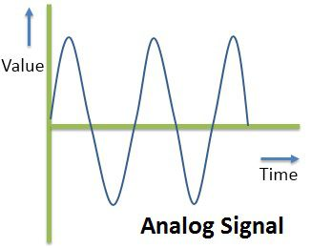
Analog Signals
Analog Signals are signals that vary all the time and can have different values all the time. The transmission of analog signals is subjected to deterioration by noise. That is why analog signals often sound scruffy and not clean. Analog requires only a small bandwidth.

Slide 6
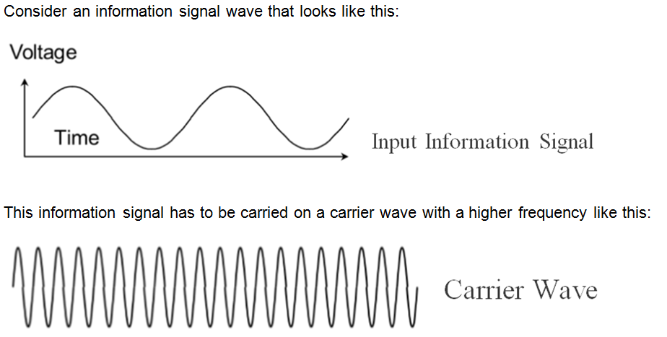
Analog Signals and AM
In amplitude modulation (AM) you vary the amplitude of the carrier wave according to the values of the information signal wave.

Slide 7
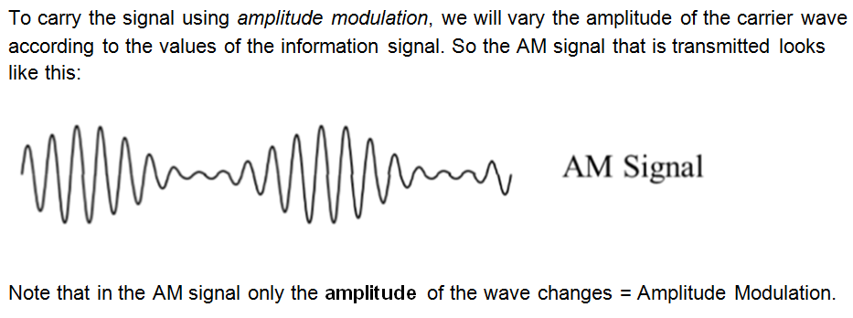
Analog Signals and AM

Slide 8
Analog Signals and FM
Frequency modulation (FM) works in a similar way, except that instead of varying the amplitude of the carrier wave, we vary only the frequency of the carrier wave according to the value of the information signal.
Again consider the information signal that looks like this:
This information signal has to be carried on a carrier wave with a higher frequency like this:

Slide 9
Analog Signals and FM

Slide 10
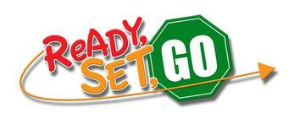
Lab Activity
We are now going to perform an experiment/activity in which you will observe analog signals in AM and analog signals in FM and compare and contrast their characteristics. We will use equipment from our COSMOS Technology Toolkit: a computer and monitor, an ADALM-PLUTO Transceiver and antenna.
The materials are already assembled on your desks. Get ready and wait for your teacher to tell you to begin

