Slide 1
Making Connections - State Lab
Ms. Shahid Living Environment

Slide 2
Do Now
Write down your partner’s response to the following questions:
What may happen to a baby if the mother started smoking?
Are smoking and low-birth weight babies directly related? How would you confirm your response?

Slide 3
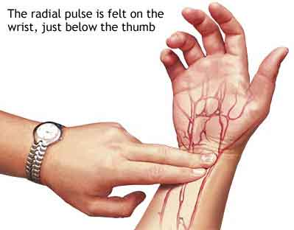
Try this: Measuring Pulse Rate by Hand
Take three measurements right now using this method (for 20 sec)
Write your numbers down. Multiply by three
Take the average of your three numbers and input this value into the Google Doc.

Slide 4
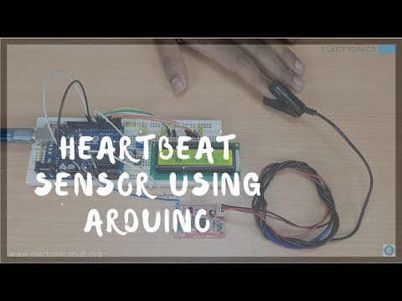
Measure Pulse Using Arduino Pulse Sensors

Slide 5
Take your pulse using Arduino!
Go to page 2 of your lab packet
Do the three trials of your pulse rate and record into the spaces provided (you do not need to multiply by three because we are already doing beats per minute)
Take the average of your three measurements, and input into the Google Doc

Slide 6
Second Period

Slide 7
Do Now
Page 4 of making connections packet - complete the questions that were skipped last time
For question 3, discuss your responses and write down your partner’s question under your own

Slide 8
Perform Part A2 of experiment
Go to pages 5 and 6 of the packet and complete questions individually
Bottom of page 5, in blank space: Discuss responses with a partner and write down similarities/differences between your responses. (5 mins)

Slide 9
Third Period

Slide 10
Presentations - Gallery Walk

Slide 11
Peer Evaluations

